Slide 1

Data Analytics using Python
12th Nov, 2018

Slide 2



Popular Data Analytics Software
1.Python
2. R
3.SAS (STATISTICAL ANALYSIS SYSTEM)

Slide 3
Why Python ?
The most ly used Data Science software.
It can be used for various development purpose and analytics purpose ,Best graphical capabilities.
Over 5000+ packages available for advanced uses for Machine Learning and AI
Cross platform : Linux, Windows, Mac.
Works well with csv, sas, spss, excel, access, Oracle, MySql etc.
Python is Free.

Slide 4

Software

Slide 5
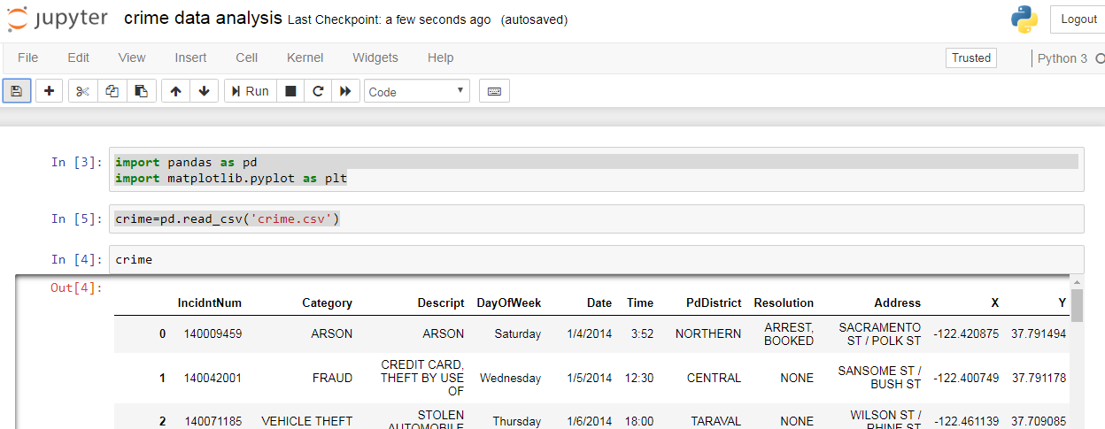
Python Anaconda Version 3 Software Interface

Slide 6
Data Types in Python
Integer
Float
Complex
String
Boolean

Slide 7
How to create an object in Python???
A=3
out:3
B=2
out:2
C=A+B
out:5
type(c)
Out:int

Slide 8
Assign a Float
myfloat = 7.0
print(myfloat)
myfloat = float(7)
print(myfloat)

Slide 9
Assign a Complex
x=3+4j
type(x)
x.real
x.imag
x.conjugate()
pow(x,2)

Slide 10
Create a Character object in Python
FirstName=“Hello”
type(FirstName)
LastName=“world”
FullName=FirstName+” ”+LastName
lotsofhellos = "hello" * 10
print(lotsofhellos)

Slide 11
Some Conditional Operations
z = 2.5
x = 50 - 30
y = "Hello"
if z==2.5 or y == 'Hello':
x = x+1
y = y+"World"
print (x)
print (y)

Slide 12
Multiple Assignment
a,b=3,2
print(a)
print(b)

Slide 13
Data Structure in Python
General Data Structure
Packages for Data Structure
Lists
Tuples
Set
Dictioneries
Numpy
Pandas
Arrays
Series
Data Frames

Slide 14
List
It is a one dimensional data structure in python.
Lists are very similar to arrays
It is a group of heterogenous data type.
listmine=[]
listmine.append(5)
listmine.append(10)
listmine.append(15)
listmine.append(20)
print(listmine)
Listmine[2]

Slide 15
Tuples
Tuples are another standard sequence data type. The difference between tuples and list is that tuples are immutable, which means once defined you cannot delete, add or edit.
x_tuple = 1,2,3,4,5
y_tuple = ('c','a','k','e')
x_tuple[0]

Slide 16
Dictioneries
Dictionaries are made up of key-value pairs.
key is used to identify the item and the value holds as the name suggests, the value of the item.
x_dict = {'Edward':1, 'Jorge':2, 'Prem':3, 'Joe':4}
del x_dict['Joe']
x_dict
x_dict['Edward']
x_dict.keys()
x_dict.values()

Slide 17
sets
Sets are a collection of distinct (unique) objects.
These are useful to create lists that only hold unique values in the dataset.
It is an unordered collection but a mutable one, this is very helpful when going through a huge dataset.
x_set = set('CAKE&COKE')
y_set = set('COOKIE')
print(x_set)
print(x_set|y_set)# Unique elements in x_set or y_set or both
print(x_set&y_set)# elements in both x_set and y_set or both

Slide 18
Numpy and Pandas
NumPy is the fundamental package for scientific computing with Python.

Slide 19
Pandas
Pandas is the Python Package providing fast Flexible and expressive data structures .
Pandas is well suited for many different kind of data
Tabular data with heterogenous column as in SQL Table or Excel Spredsheet.
Matrix data with row column
Any other form of Statistical/Obsevational data
Pandas is consist of two Primilarily data structure
Series
Dataframe

Slide 20
Case Study on International Airlines Data Using Pandas Packages
import pandas as pd
import matplotlib.pyplot as plt
crew= pd.read_csv('crew.csv')
print(crew)

Slide 21
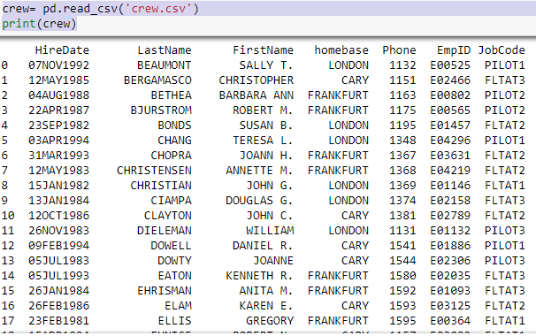
Data Set Output

Slide 22
Commonly Used Function
#To browse Top Five Rows
crew.head()
#To browse Bottom Five Rows
crew.tail()
#To Browse Number of Obsevetion
crew.count()
#Using Statistical Function
crew[‘Salary’].sum()
Crew[‘Salary’].mean()
Crew[‘Salary’].max()
Crew[‘Salary’].min()
Crew.describe() #Statistical Overview

Slide 23
Data Extraction and Manipulation
# To add a Computed Column
crew['bonus']=crew.Salary*.1
# Etract the Colunns and create a Subset
crew1 =crew[['JobCode', 'homebase','Salary']]
#Conditional Data Extraction
Fltat=crew[crew.JobCode=="FLTAT1"]
crew_sal=crew[crew.Salary >90000]
crew_sal_less=crew[crew.Salary<=75000]
#Creating Ascending abd Descending Ordered Report
crew_sorted = crew.sort_values("Salary",ascending=True)
crew_desc_sorted = crew.sort_values("Salary",ascending=False)

Slide 24
Data Visualization in Python
#Import the package for Data Visualization
%matplotlib inline
import matplotlib.pyplot as plt
import numpy as np
import pandas as pd
#Creating ScatterPlot
women=pd.read_csv("women.csv")
women
plt.plot(women['height'],women['weight'], '*--', label='linear',color='Green')
plt.xlabel('Height')
plt.ylabel('Weight')
plt.title('The Scatterplot of Women')
plt.show()

Slide 25
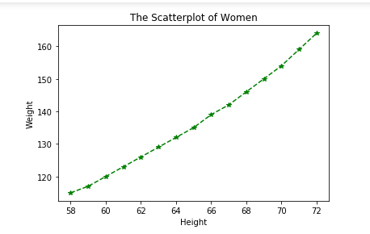
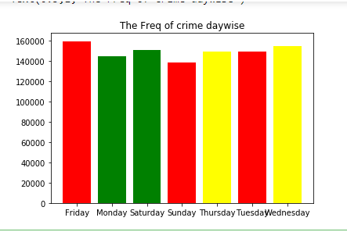
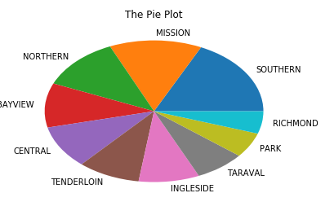
Data Visualization Report

Slide 26
CASE STUDY ON
CRIME DATA ANALYSIS

Slide 27
The Problem & Data Analytics
In the last few years most of the American cities have recorded a low crime rate. However, San Francisco Bay area saw an up surge in crimes reported in these years.
The need for anticipating and take preventive measures have become the utmost priority for the local government authorities.
The crime records of the area for the last few years need to be mined , analyzed and used to forecast the crime that can be committed in future.

Slide 28
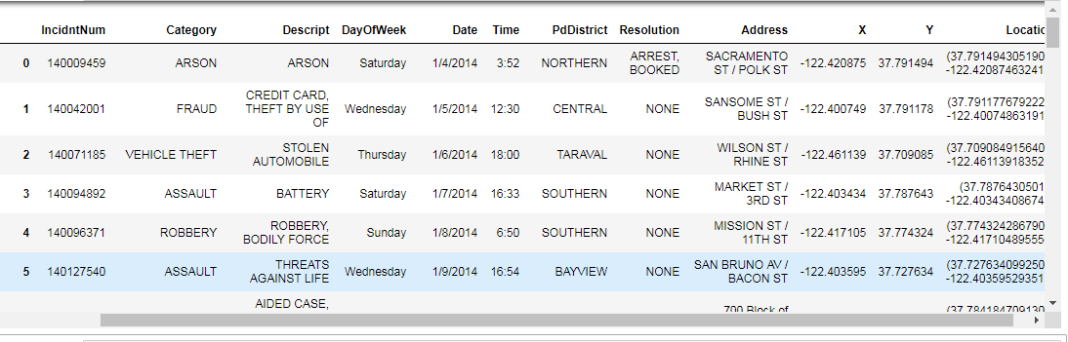
Reading data into Python
import pandas as pd
import matplotlib.pyplot as plt
crime=pd.read_csv('crime.csv')

Slide 29
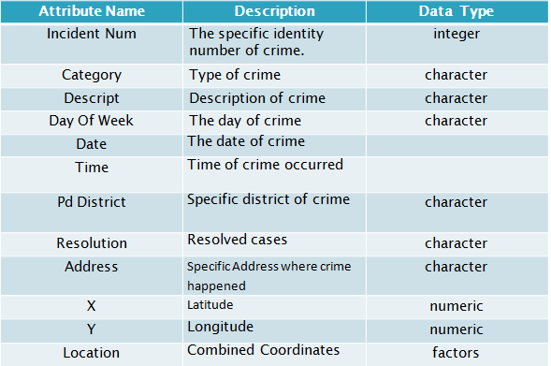
Data Description

Slide 30
What can the data possibly tell
1.How many crimes have been reported in each category of crime?
2.Which day of the week sees the highest number of crimes recorded ?
3.Frequency of crimes resolved to that of pending.
4.How many crimes have been reported by each PdDistrict ?

Slide 31
Packages in Python for this Case Study
Numpy
Pandas
matplotlib

Slide 32
1. How many crimes have been reported in each category?
#To obtain the frequency of each category
count_category=crime['Category'].value_counts()
count_category
# To obtain the data type
type(count_category)
#Convert it into data frame
df=pd.DataFrame(count_category)
df
#Reset the index of Data frame
DF1=df.reset_index()
DF1
#Reset the column Name
DF1.columns=[‘Category','Freq']
DF1
#Creating a Sample
Sample=DF1.head()
Sample
Barplot of number of crimes per category
plt.bar(Sample['Category'],Sample['Freq'],color="Red")
plt.title("The Freq of Category of Crime")
plt.show()

Slide 33
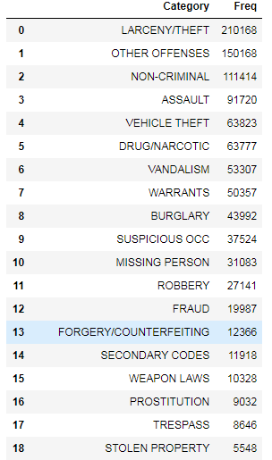
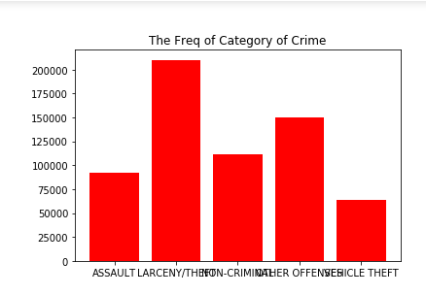
Result

Slide 34
An Alternative Way
import pandas as pd
crime=pd.read_csv('samplecrime.csv')
count_category=crime['Category'].value_counts().to_dict()
count_category = pd.DataFrame(list(count_category.items()), columns=['Category', 'Frequency'])
#if you are using 2.X then no need to use list print(count_category)

Slide 35
2.Which day of the week sees the highest number of crimes recorded ???
#To obtain the daywise frequency of crime reported
count_Dayofweek=crime['DayOfWeek'].value_counts()
count_Dayofweek
type(count_Dayofweek)
df2=pd.DataFrame(count_Dayofweek)
df2
DF2=df2.reset_index()
DF2
DF2.columns=['Dayofweek','Freq']
DF2
#To obtain a barchart representing Day wise Frequecy of Crime Reported
plt.bar(DF2['Dayofweek'],DF2['Freq'],color=['Red','Yellow','Green'])
plt.title('The Freq of crime daywise')
plt.show()

Slide 36
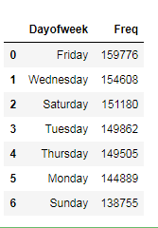
Result

Slide 37
3.Crime resolved out of total
#To obtain the Frequency of Crime resolved
count_resolved=crime['Resolution'].value_counts()
count_resolved
type(count_resolved)
df4=pd.DataFrame(count_resolved)
DF4=df4.reset_index()
DF4
DF4.columns=['Resolution','Freq']
DF4
#To obtain the List
x=["Arrest","Pending"]
y=[sum(DF4.iloc[[0,1],1]),sum(DF4.iloc[2:17,1])]
representing current status of Crime Resolution
plt.bar(x,y,color=["Green","Red"])
plt.xlabel("Resolution")
plt.ylabel("Frequency")
plt.title("The Resolved vs Pending Cases")
plt.show()

Slide 38
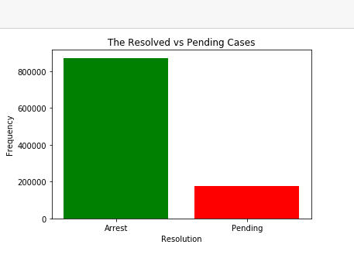
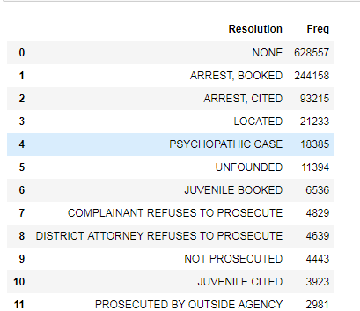
Result

Slide 39
4. Number of Crimes recorded in each PdDistrict
#To obtain the frequecy report of Crime per districtwise
count_Pd_district=crime['PdDistrict'].value_counts()
count_Pd_district
type(count_Pd_district)
# Convert into DataFrame
df3=pd.DataFrame(count_Pd_district)
df3
#Change the index
DF3=df3.reset_index()
DF3
DF3.columns=['PdDistrict','Freq']
DF3
#To obtain the piechart representing districtwise frequency of Crime
plt.pie(DF3['Freq'], labels=DF3['PdDistrict'])
plt.title("The Pie Plot")
plt.show()

Slide 40
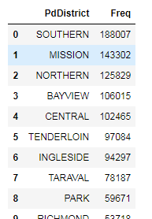
Result

Slide 41

Regression
Linear Regression
Polynomial Regression
Logistic Regression (*used for classification)

Slide 42
Types of Data
1. Quantitative – Discrete, Continuous
2. Qualitative – Nominal,Ordinal,Dichotomous
Data can also be represented as :
Numeric – Age, Height, Salary etc.
Categorical – Gender, City, Department

Slide 43
Some Statistical Concepts
The field of Statistics can be broadly defined under :
1. Descriptive Statistics – To know what has already happened.
2. Inferential Statistics – What can happen
given that something has already happened.

Slide 44
Descriptive Statistics
The most important measures of Descriptive Statistics are :
1. Measures of Central Tendancy – Mean, Median, Mode
2. Measures of Dispersion – Deviation, Range, Inter-quartile Range

Slide 45
Correaltion , Covariance, Regression
Covariance – The joint variability between two variables.
Correlation – The measure of variability of two variables. Ranges between -1,1.
“ Correlation is not causation “
Regression - A technique for determining the statistical relationship between two or more variables where a change in a dependent variable is associated with, and depends on, a change in one or more independent variables.

Slide 46
Types of Variable when Forecasting
There are two types of variables considered while prediction.
Dependent / Response Variable – The value of which is dependent on other variables.
Independent/ Predictor Variable – The values of which influence the values of the dependent or response variable

Slide 47
Linear Regression
It is one of the most widely known modeling technique. Linear regression is usually among the first few topics which people pick while learning predictive modeling. In this technique, the dependent variable is continuous, independent variable(s) can be continuous or discrete, and nature of regression line is linear.
Linear Regression establishes a relationship between dependent variable
(Y) and one or more independent variables (X) using a best fit straight
line (also known as regression line).
It is represented by an equation Y=a+b*X + e, where a is intercept, b is slope of the line and e is error term. This equation can be used to predict the value of target variable based on given predictor variable(s).
The difference between simple linear regression and multiple linear regression is that, multiple linear regression has (>1) independent variables, whereas simple linear regression has only 1 independent variable. Now, the question is “How do we obtain best fit line?”.

Slide 48
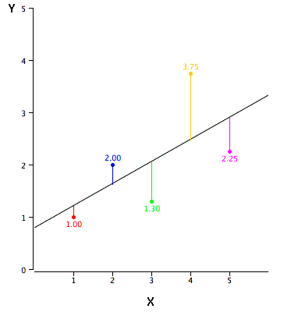
Linear Regression
How to obtain best fit line (Value of a and b)?
This task can be easily accomplished by Least Square Method. It is the most common method used for fitting a regression line. It calculates the best-fit line for the observed data by minimizing the sum of the squares of the vertical deviations from each data point to the line. Because the deviations are first squared, when added, there is no cancelling out between positive and negative values.

Slide 49
Linear Regression
Important Points:
There must be linear relationship between independent and Dependant variables
Multiple regression suffers from multicollinearity, autocorrelation, heteroskedasticity.
Linear Regression is very sensitive to Outliers. It can terribly affect the
regression line and eventually the forecasted values.
Multicollinearity can increase the variance of the coefficient estimates and make the estimates very sensitive to minor changes in the model. The result is that the coefficient estimates are unstable
In case of multiple independent variables, we can go with forward selection, backward elimination and step wise approach for selection of most significant independent variables.

Slide 50
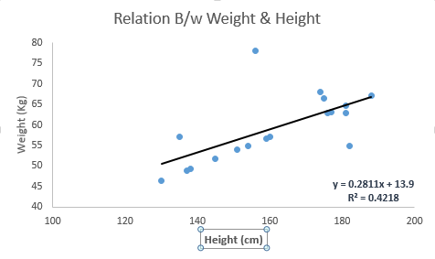
Linear Regression

Slide 51
Logistic Regression
Logistic regression is used to find the probability of event=Success and event=Failure. We should use logistic regression when the dependent variable is binary (0/ 1, True/ False, Yes/ No) in nature. Here the value of Y ranges from 0 to 1 and it can represented by following equation.
odds= p/ (1-p) = probability of event occurrence / probability of not event occurrence
ln(odds) = ln(p/(1-p))
logit(p) = ln(p/(1-p)) = b0+b1X1+b2X2+b3X3....+bkXk
Above, p is the probability of presence of the characteristic of interest.
A question that you should ask here is “why have we used log in the equation?”.
Since we are working here with a binomial distribution (dependent variable), we need to choose a link function which is best suited for this distribution. And, it is logit function. In the equation above, the parameters are chosen to maximize the likelihood of observing the sample values rather than minimizing the sum of squared errors (like in ordinary regression).

Slide 52
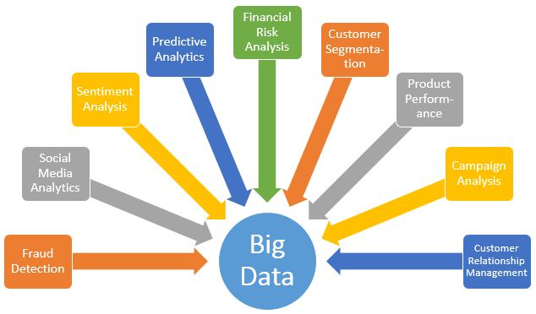
Data Analytics Across Domains

Slide 53
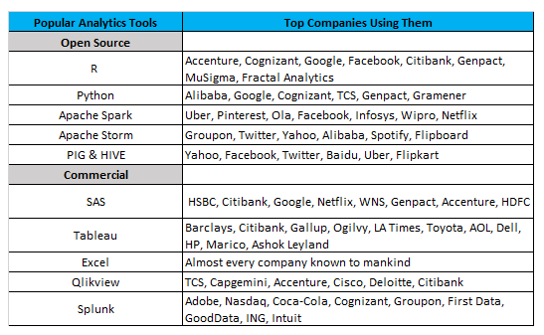
Top Companies using most Popular Data Analytics Tools

Slide 54
Thank You

